Slide 1
Burner Check - Task
Technical Development Program
SPREAD 2016

Slide 2
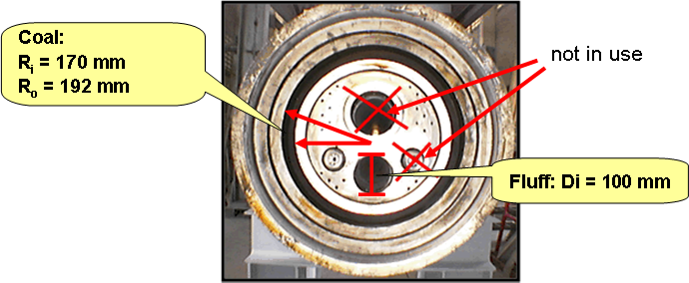
Burner Check Case Study - TASK
Purpose: Get familiar with the Burner Check Tool
Tasks
You made a Burner Check during the heat balance and filled out the spreadsheet already. The only thing that is missing for the evaluation is completing the spreadsheet with the dimensions of the coal and fluff channel dimensions of the burner. Use the information below and fill it in the burner check so that you get the fuel injection velocities.

Slide 3
Burner Check Case Study - TASK
Assess the results of the Burner Check and compare them with the guidevalues. Do you have suggestions to change/improve the burner setting?
Understanding the influence of input parameters: - Which key values change in the burner check if you modify the fuel split to calciner to 55% - Which key values change if you modify the heat value of coal/petcoke mix to 29’000 kJ/kg?
A colleague mentioned that wrong alignment could have a negative effect on the S-volatility. What are the basic settings for alignment and how can you verify if the burner is correctly aligned?
3

